Slide 1


SOFTWARE ENGINEERING
& PROJECT MANAGEMENT
Agile Tools
Subject Code: BCS501
Name:
Gagan Naganand Keni
USN:
1BI22CS054

Slide 2

SOFTWARE ENGINEERING
& PROJECT MANAGEMENT
Agile Tools
Subject Code: BCS501
Name:
Gagan Naganand Keni
USN:
1BI22CS054

Slide 3
SOFTWARE ENGINEERING
& PROJECT MANAGEMENT
Agile Tools
Subject Code: BCS501
Name:
Gagan Naganand Keni
USN:
1BI22CS054

Slide 4


Agile Tools
Agile is a project management methodology used to break complex projects into smaller, more focused chunks so teams can work in short, incremental phases.
As its name suggests, “agile” means moving fast and managing shifting priorities.
Tools used to make project management agile are called Agile Tools.

Slide 5


Agile Tools
is an agile and compact project management software that gives small, medium, and enterprise owners a tool to manage their projects remotely.
It offers a robust set of tools for project scoring, roadmap design, and task alignment.
Agile is a project management methodology used to break complex projects into smaller, more focused chunks so teams can work in short, incremental phases.
As its name suggests, “agile” means moving fast and managing shifting priorities.
Tools used to make project management agile are called Agile Tools.

Slide 6
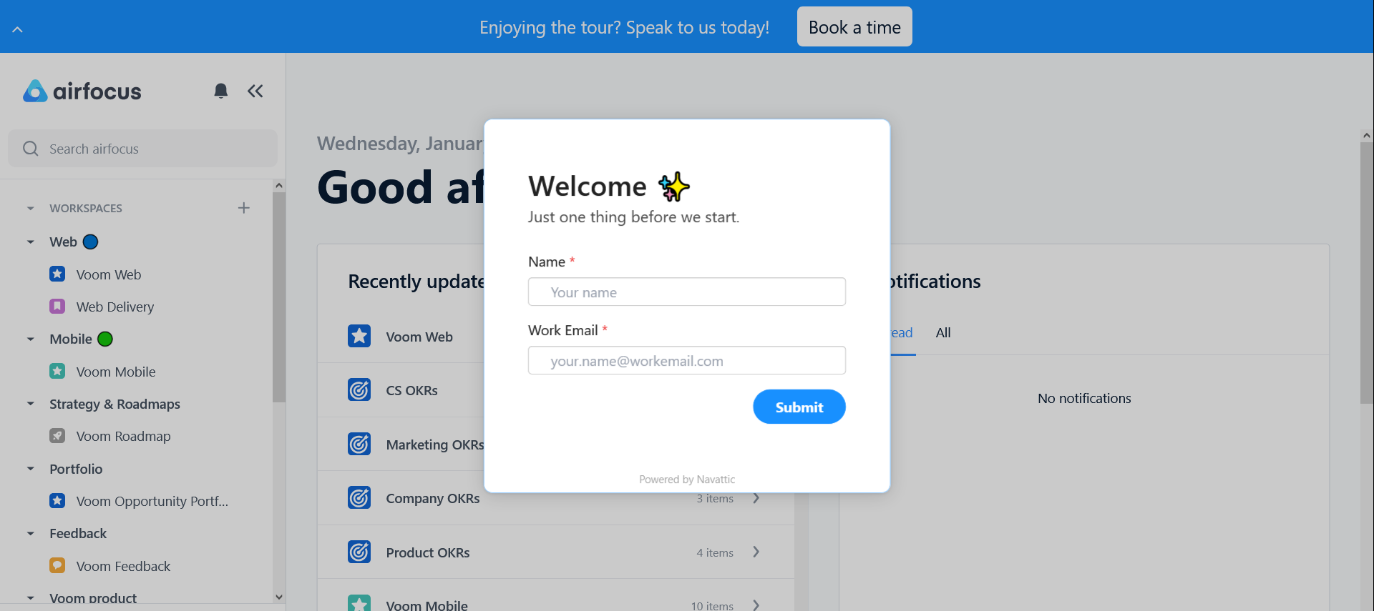
is an agile and compact project management software that gives small, medium, and enterprise owners a tool to manage their projects remotely.
It offers a robust set of tools for project scoring, roadmap design, and task alignment.

Slide 7
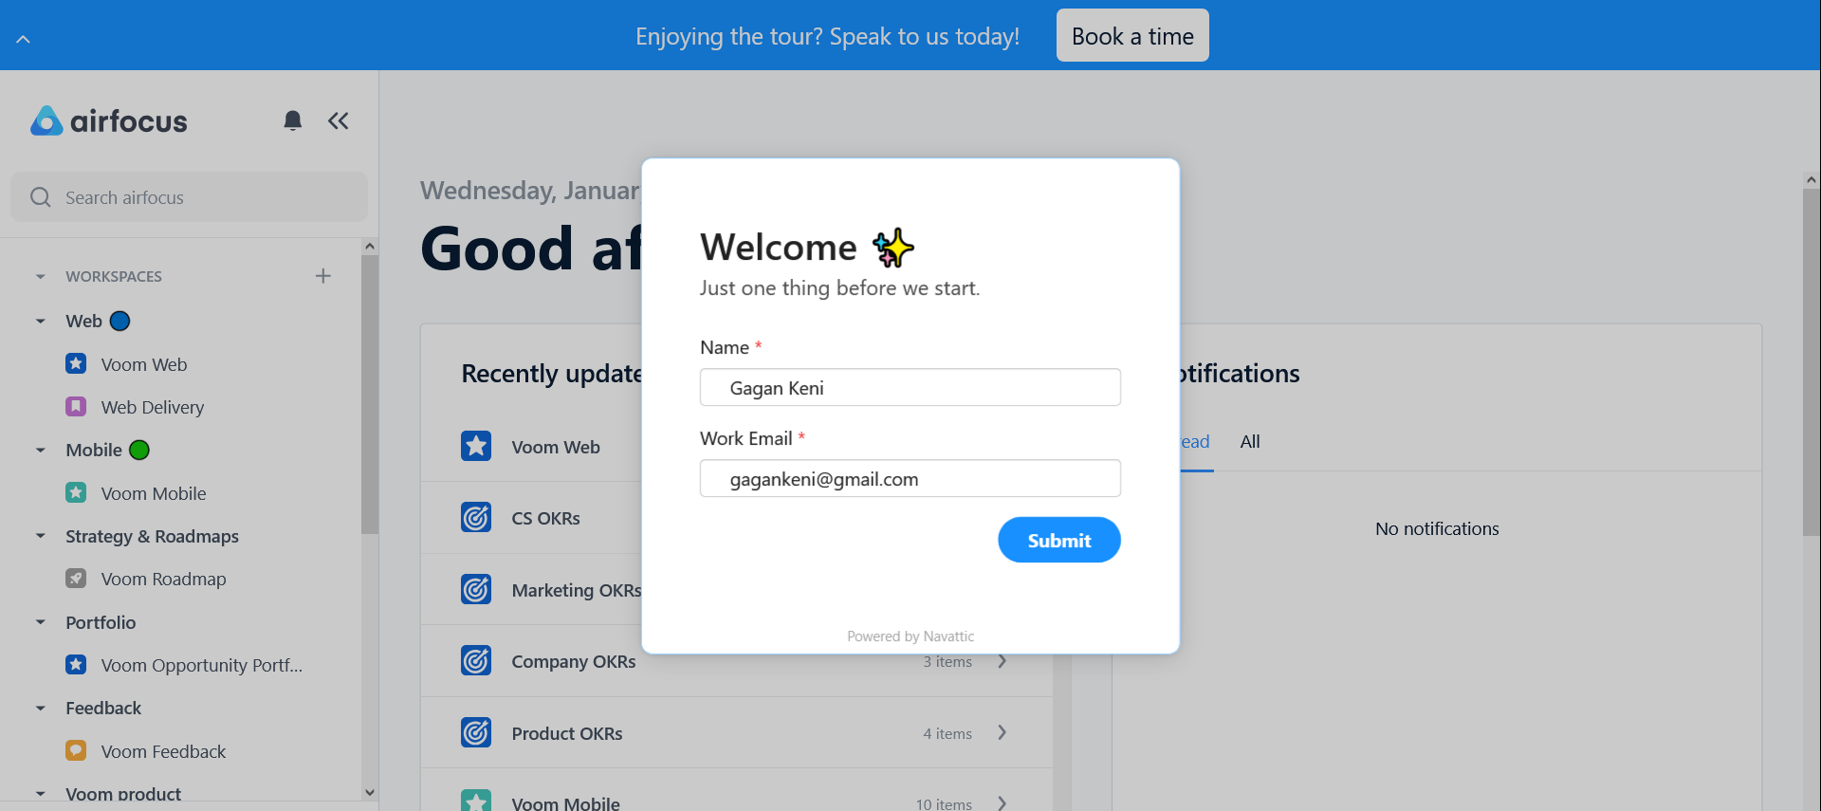
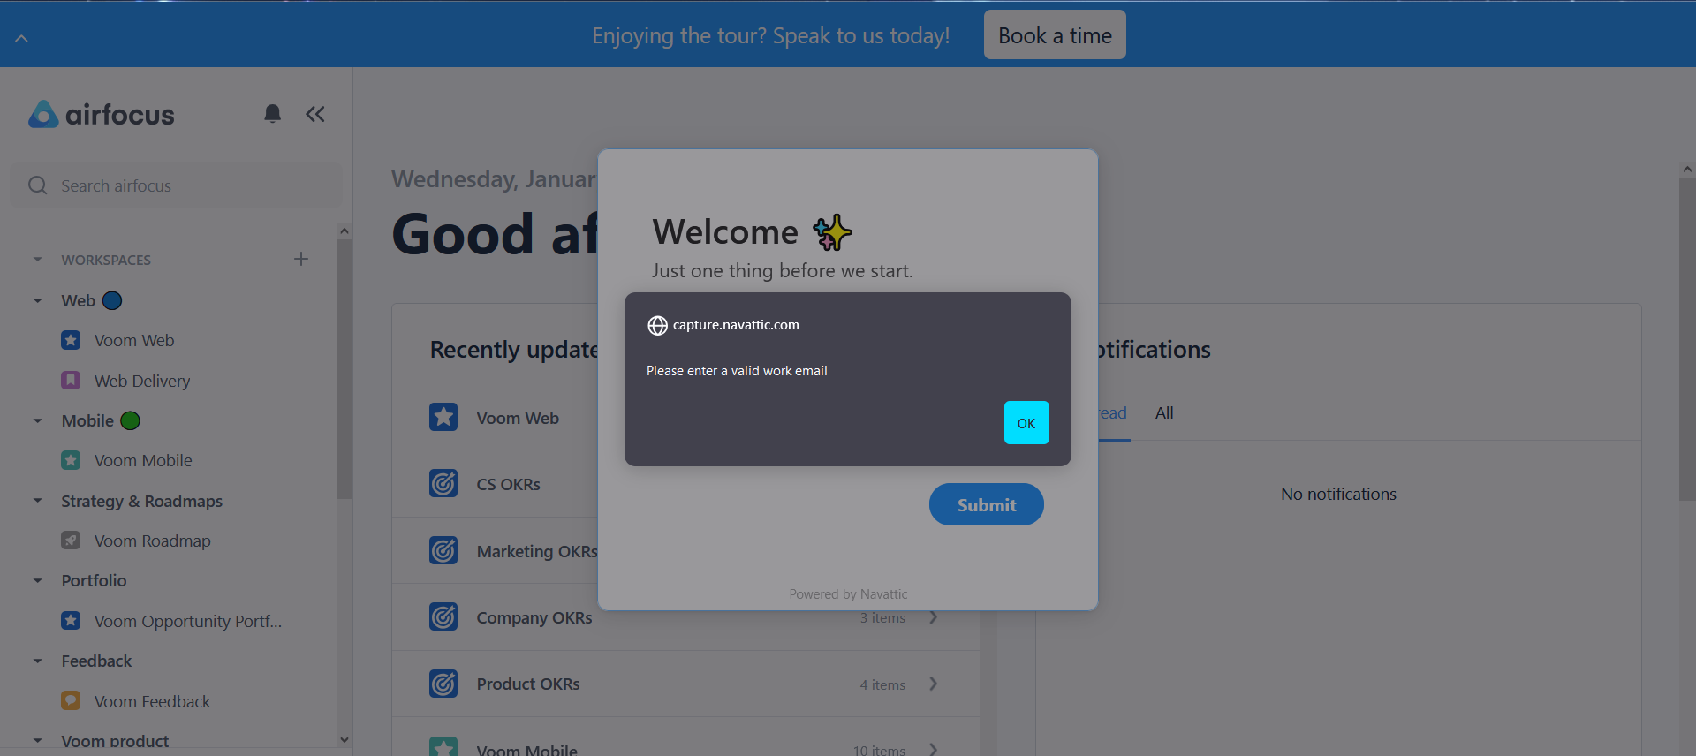

Slide 9


Slide 10
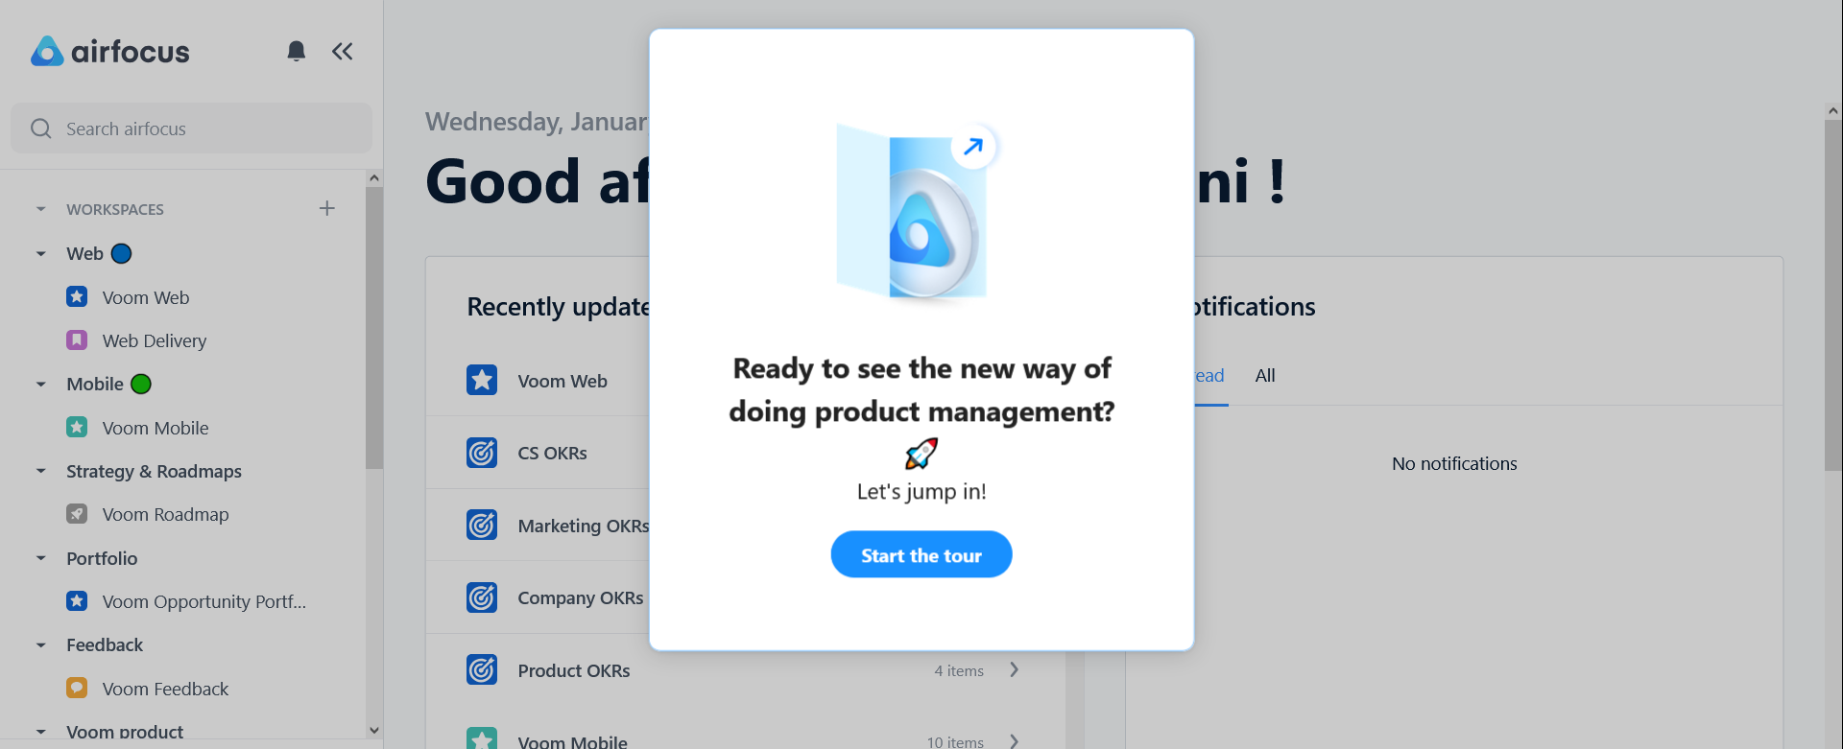

Slide 12
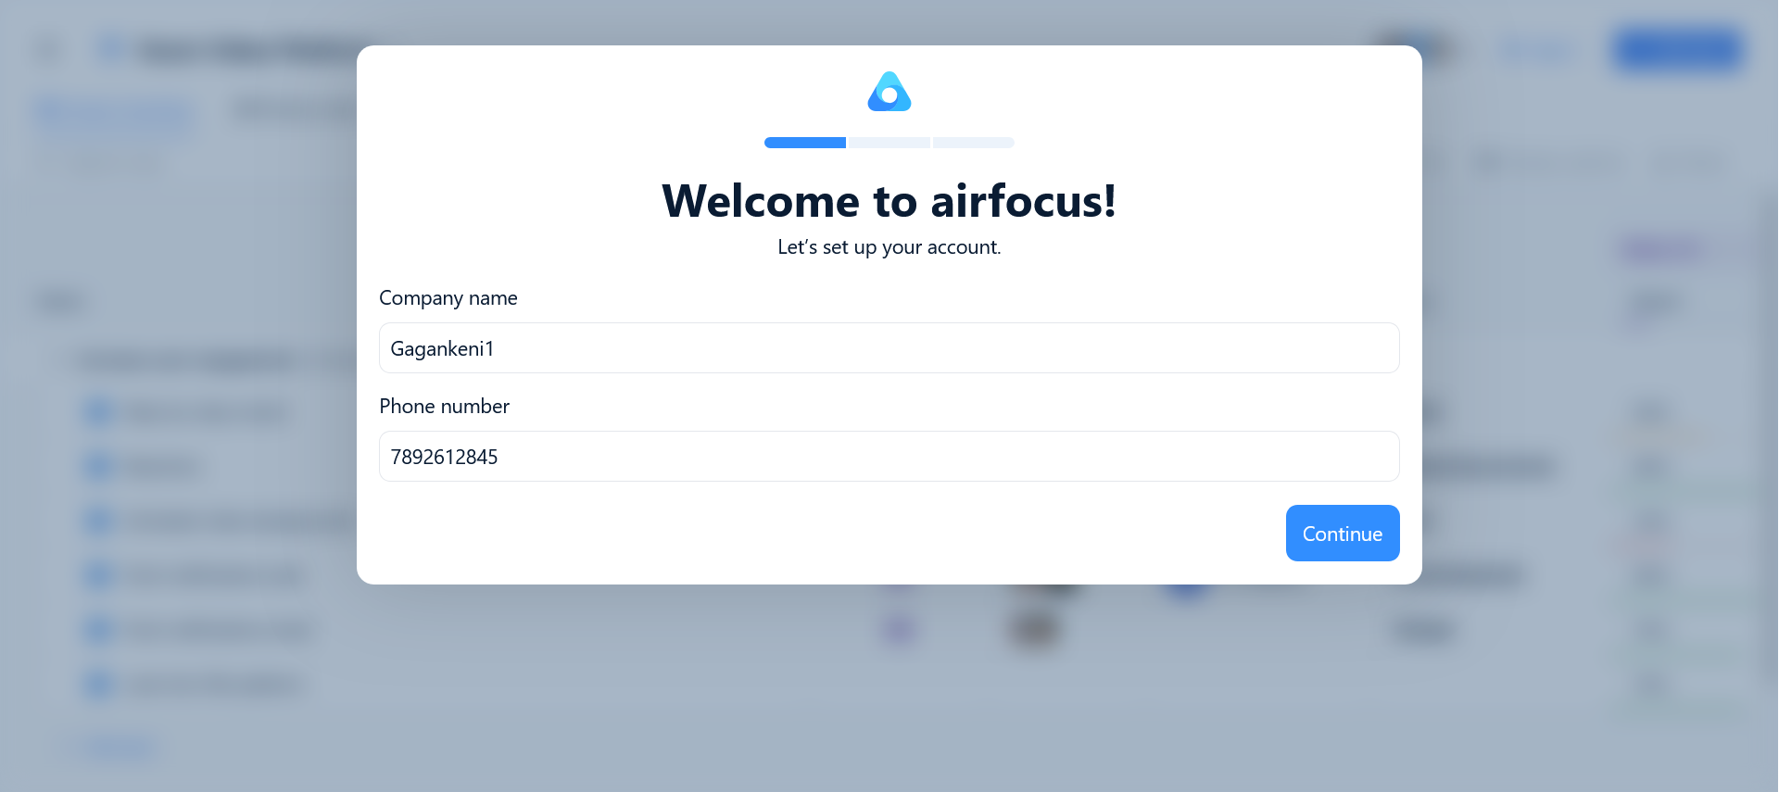

Slide 13
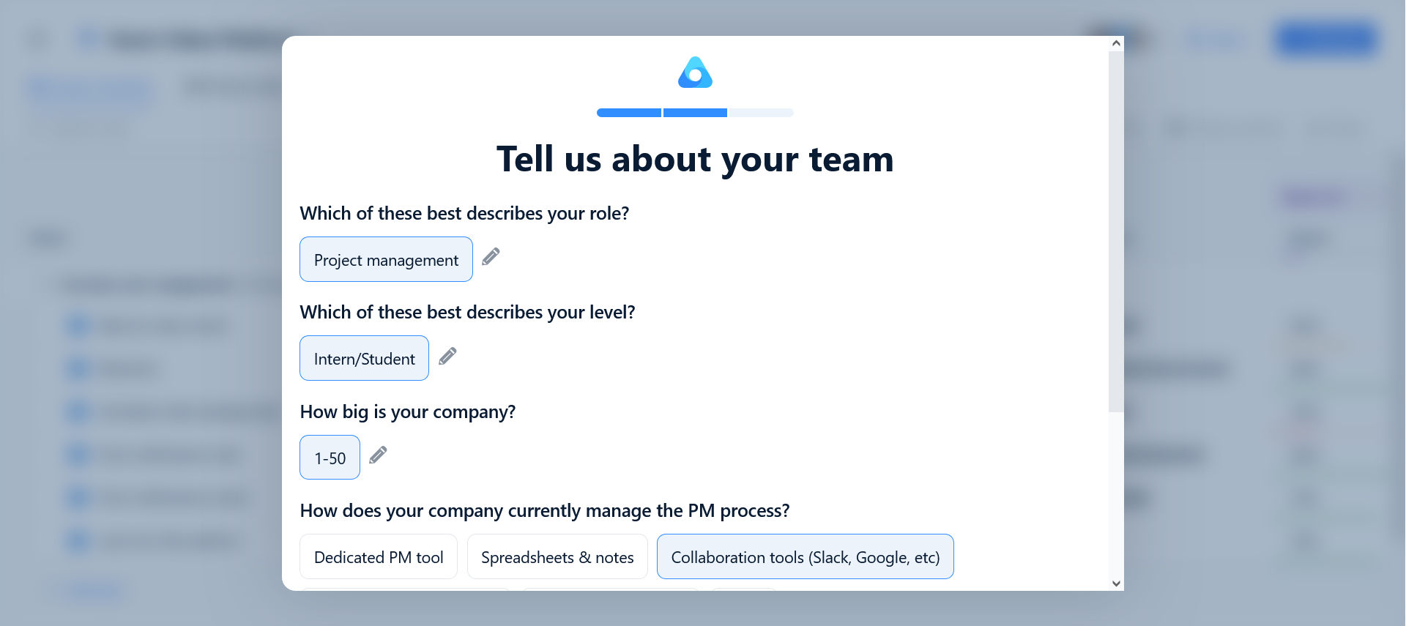

Slide 14
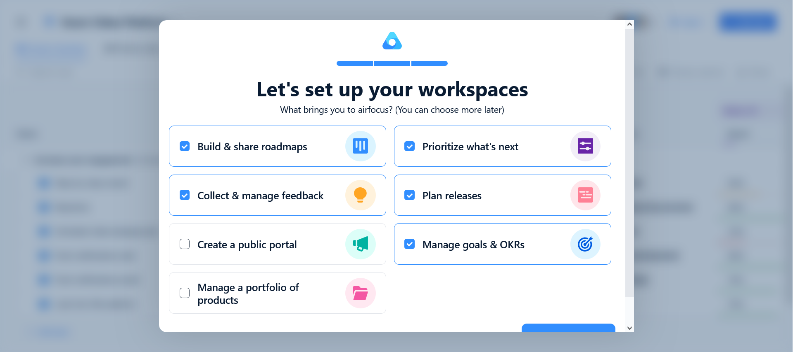

Slide 15
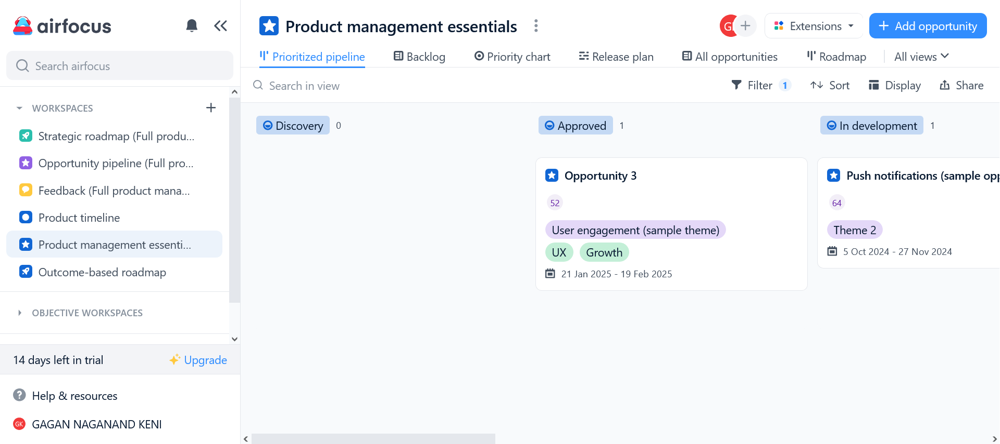
List of the different workspaces, i.e. collection of various projects with differing purposes

Slide 16
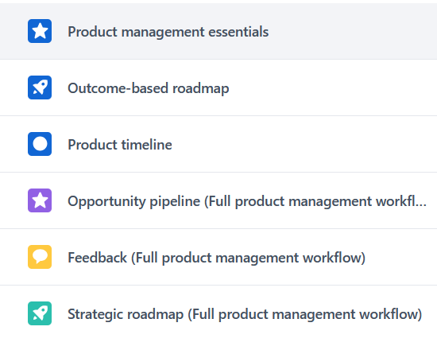
List of the different workspaces, i.e. collection of various projects with differing purposes

Slide 17

Product management essentials
List of the different workspaces, i.e. collection of various projects with differing purposes

Slide 18

Product management essentials
List of the different workspaces, i.e. collection of various projects with differing purposes

Slide 19
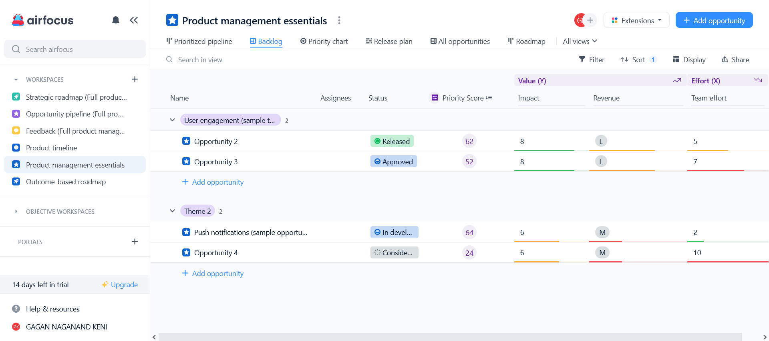

Product management essentials

Slide 20
Name of Task:
The tasks to be done.
Assignees:
The names of team members assigned to the tasks.
Status:
Current status of tasks.

Slide 21
Name of Task:
The tasks to be done.
Assignees:
The names of team members assigned to the tasks.
Status:
Current status of tasks.

Slide 22
Priority Score:
A rating given to each task based on its importance and priority to the project schedule.

Slide 23
Impact Factor & Revenue:
Impact is the measure of how much the task’s completion will impact the project.
Revenue is the measure of how much income the project will generate.

Slide 24
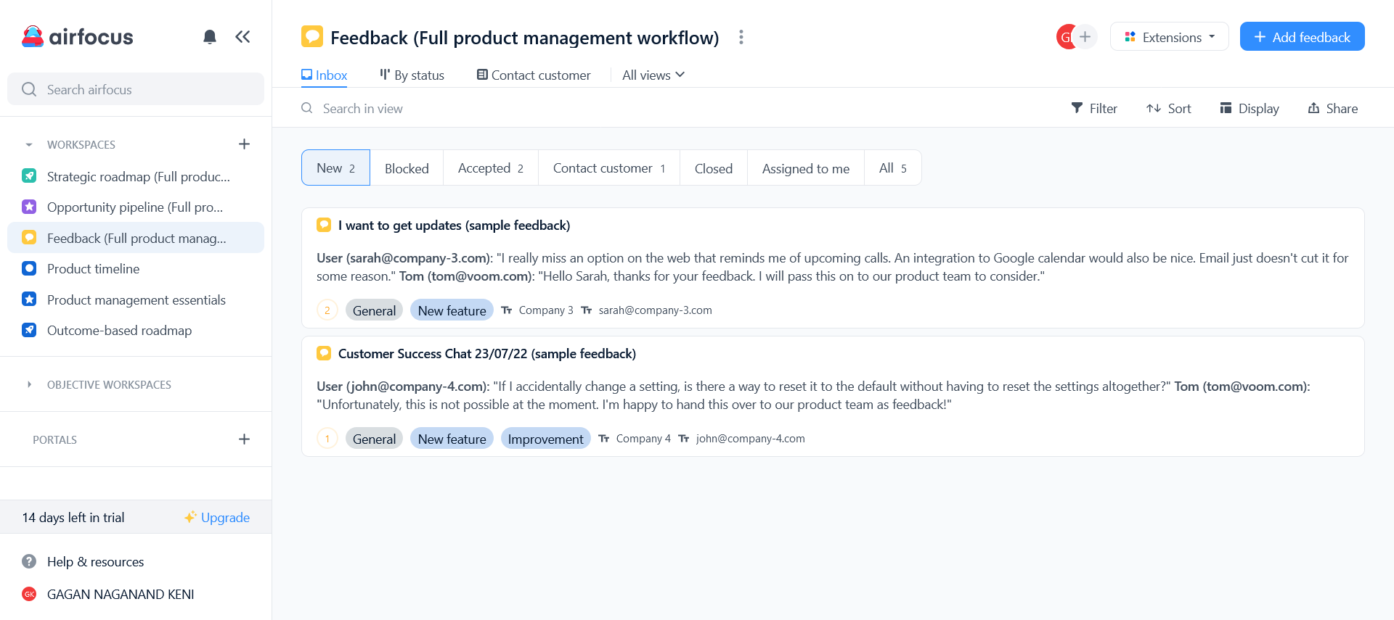
Team effort:
Indicates the amount of team labor required to complete task.

Slide 25

Team effort:
Indicates the amount of team labor required to complete task.
Feedback

Slide 26


Feedback

Slide 27

Feedback

Slide 28
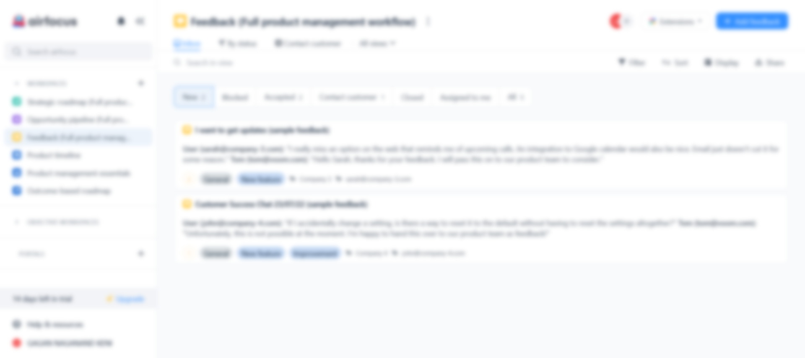
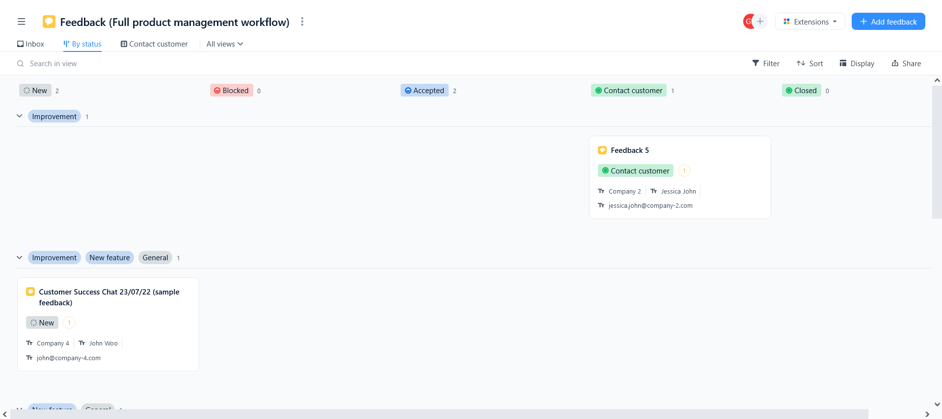

Slide 29
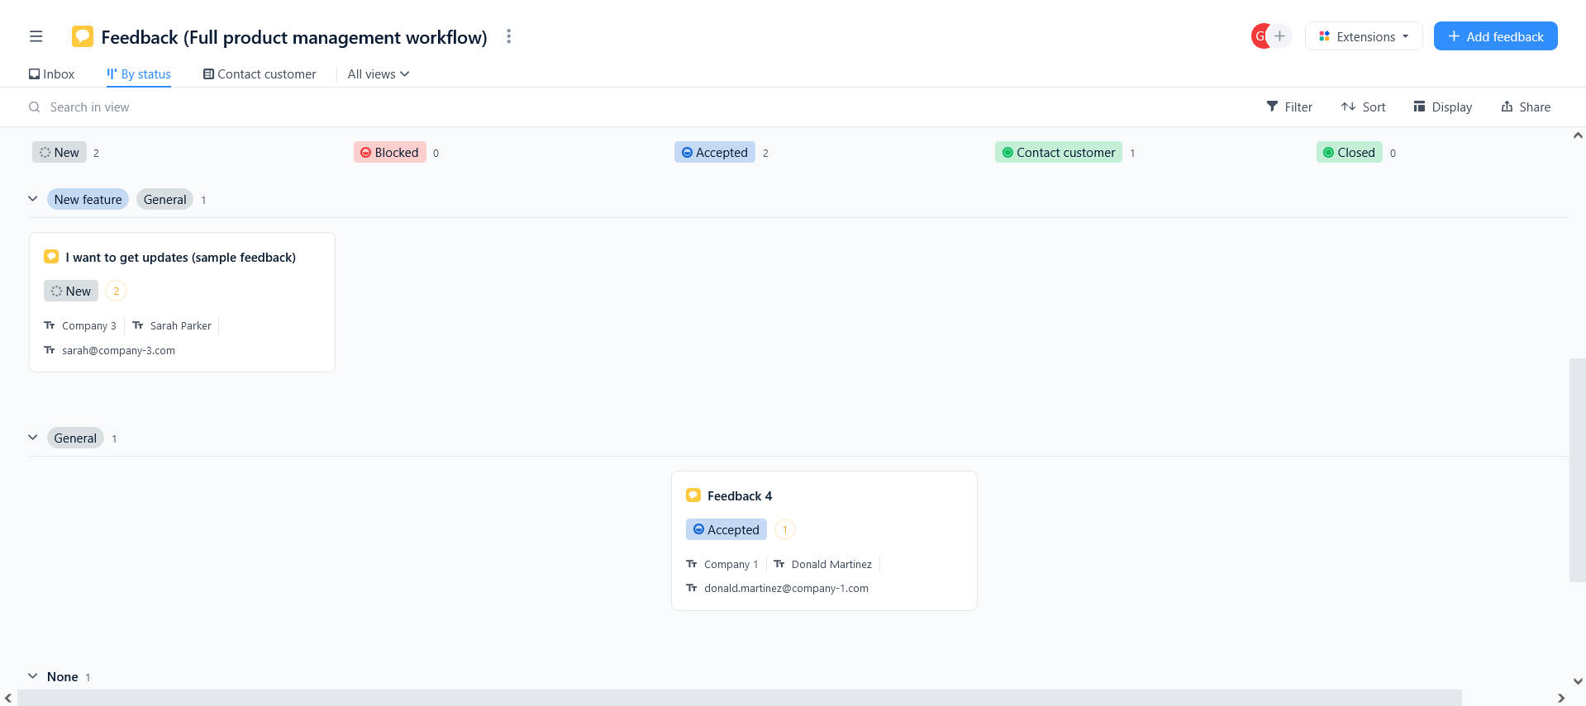

Slide 31
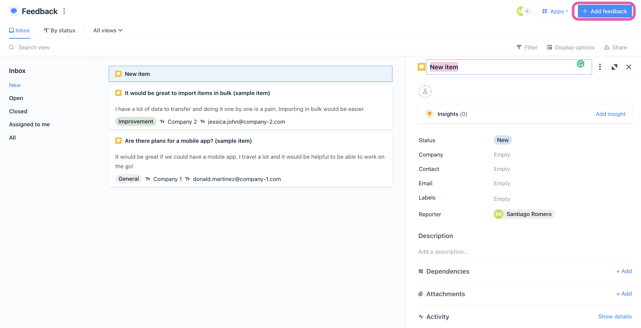
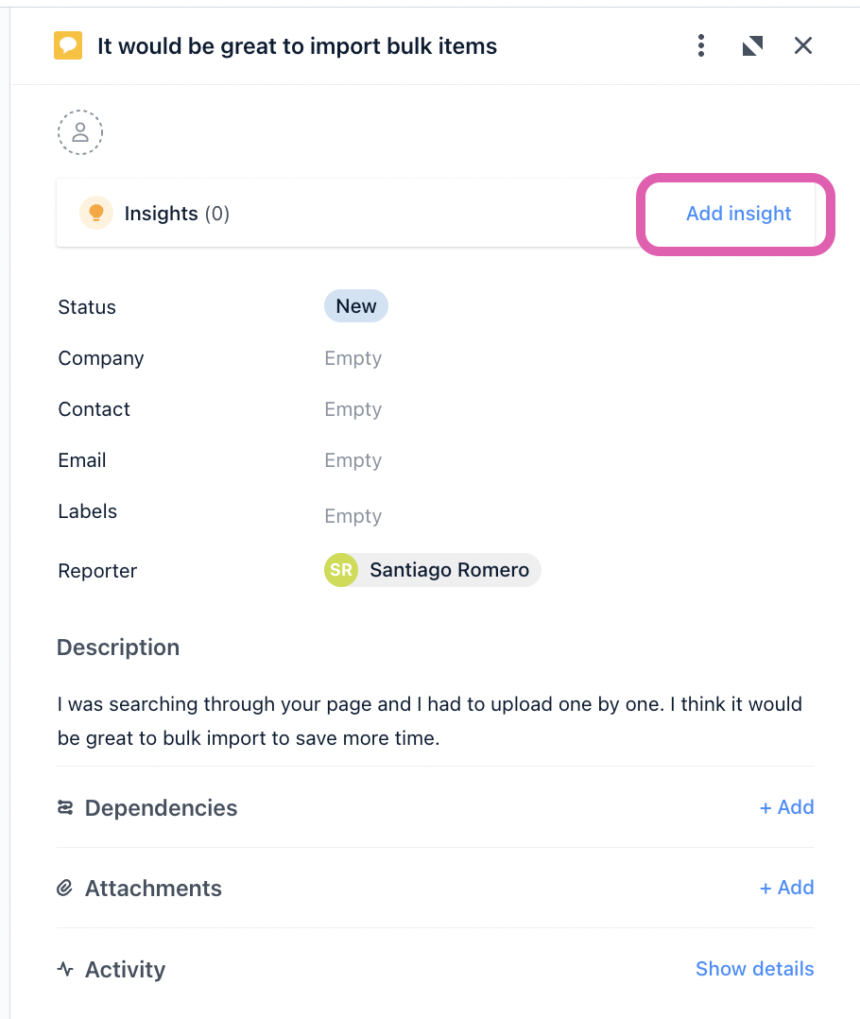

Slide 32
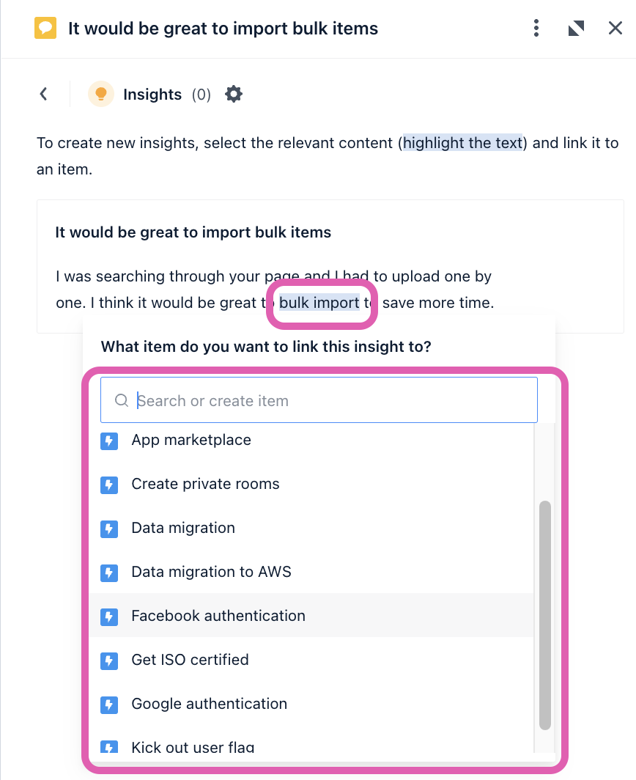
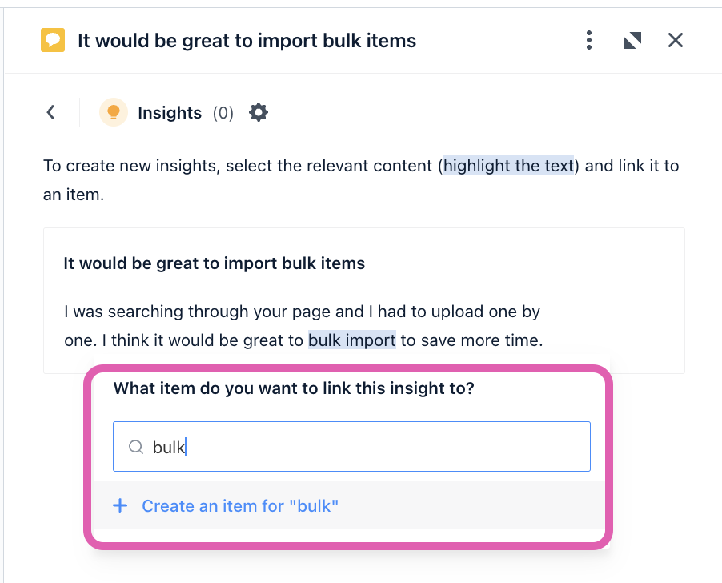

Slide 33
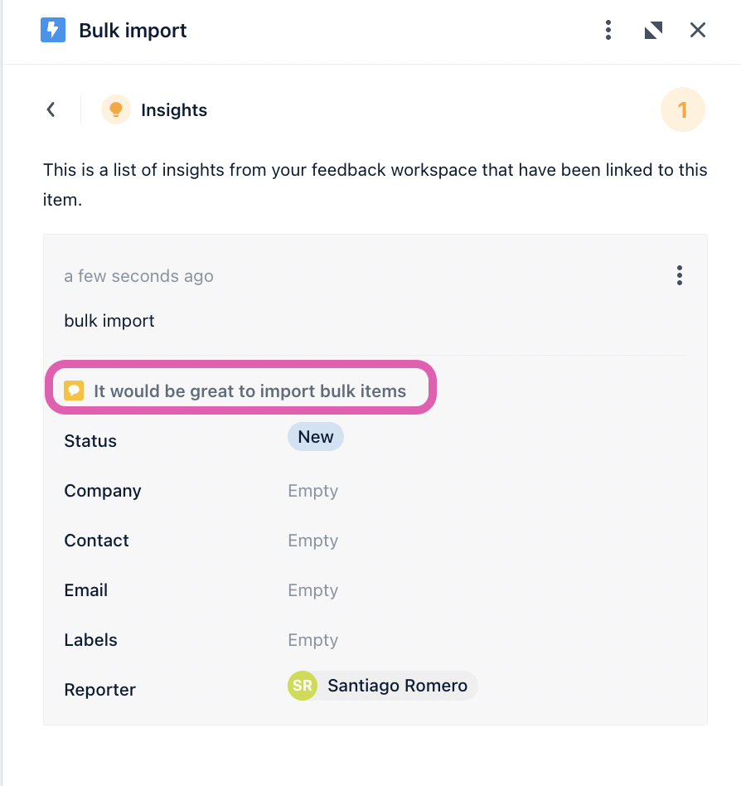
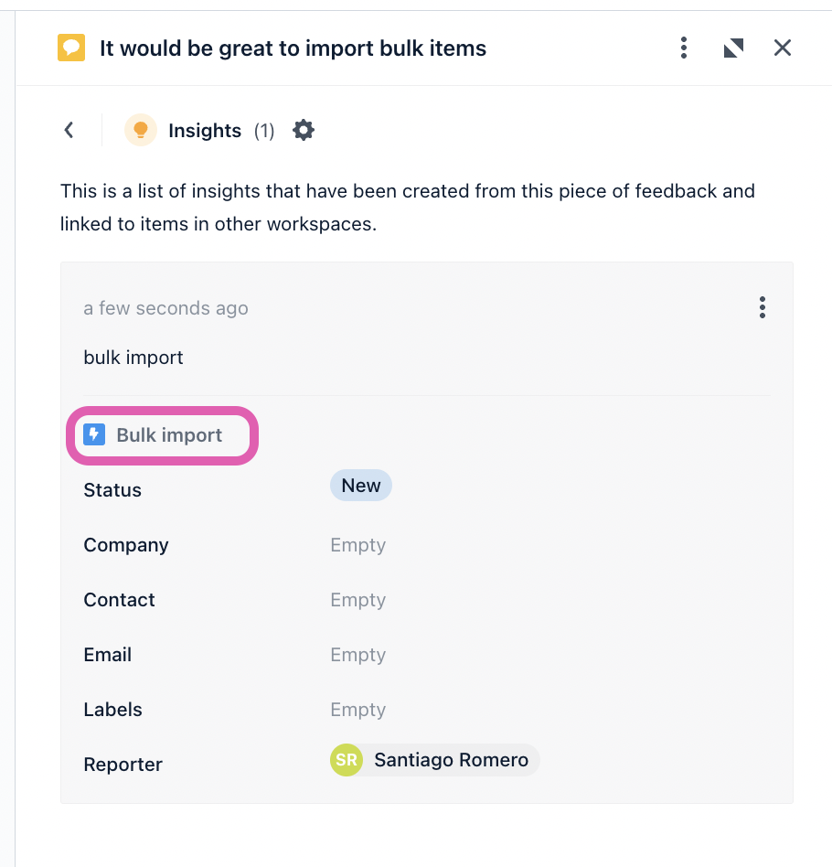

Slide 34
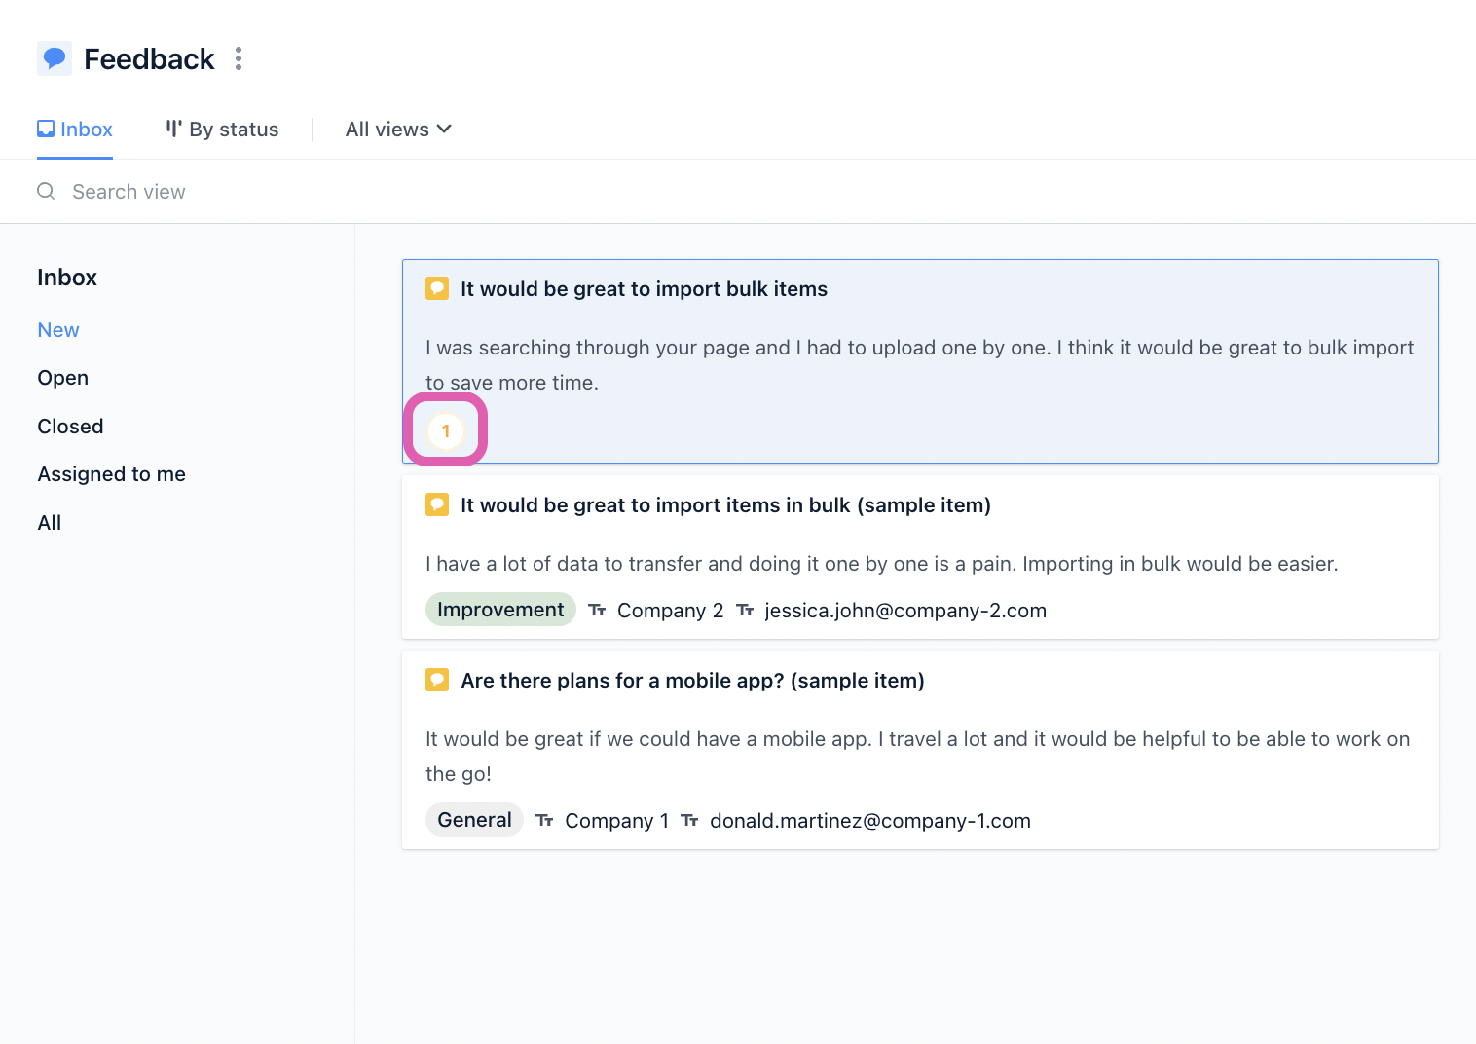

Slide 35

Outcome-based
roadmap

Slide 36
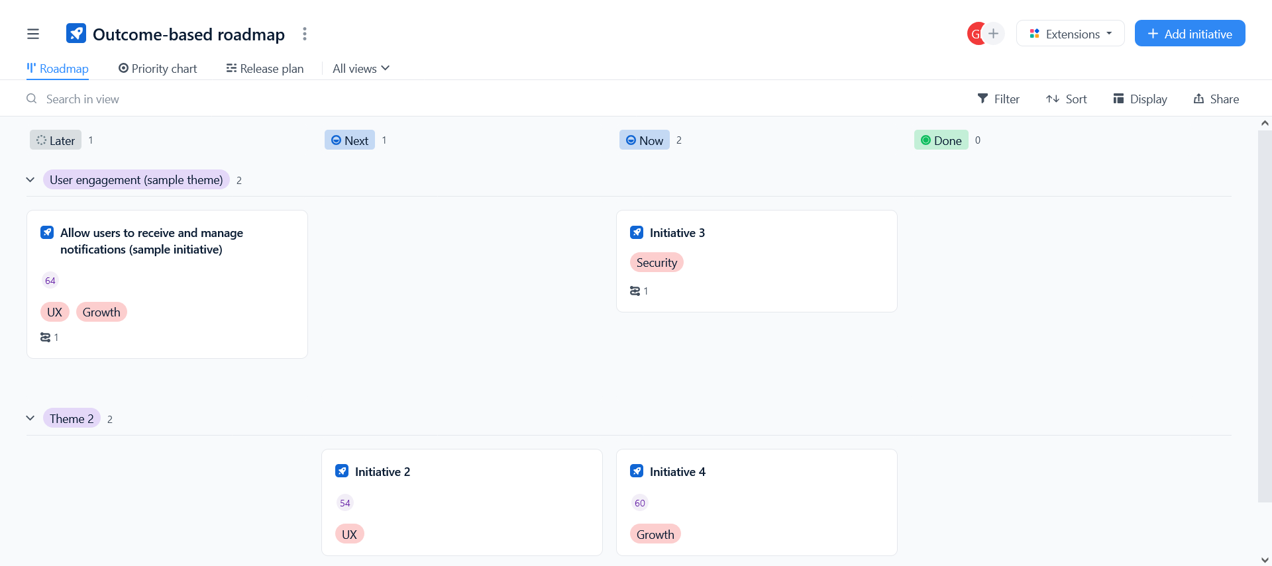

Outcome-based
roadmap

Slide 37
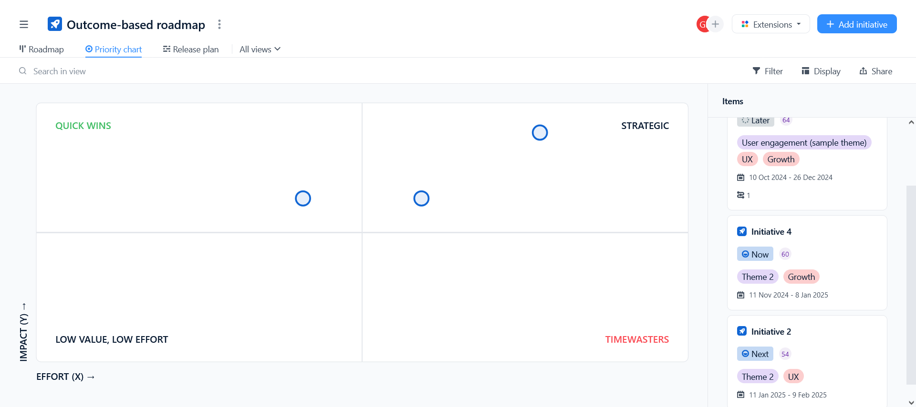

Outcome-based
roadmap

Slide 38
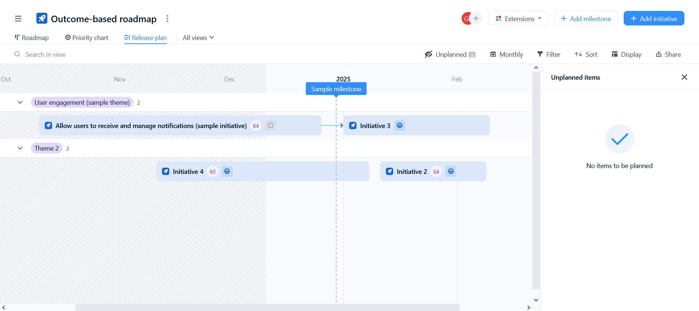

Slide 39

Strategic
roadmap

Slide 40
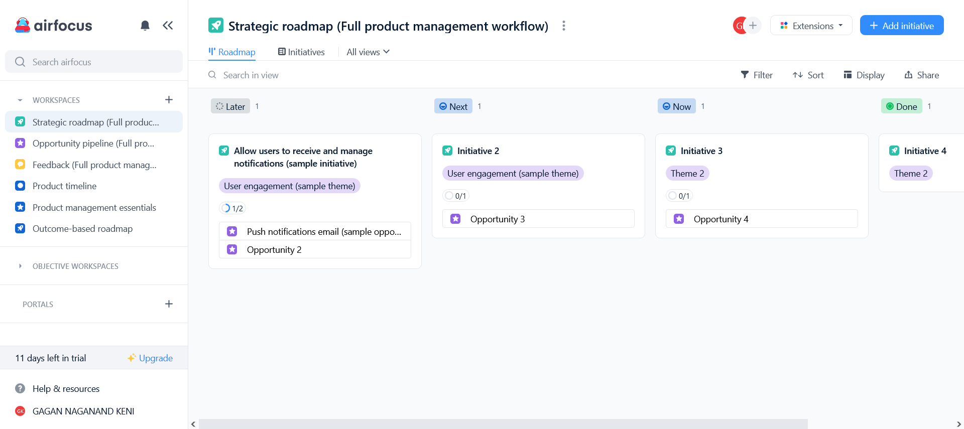
Strategic
roadmap

Slide 41

Strategic
roadmap

Slide 45
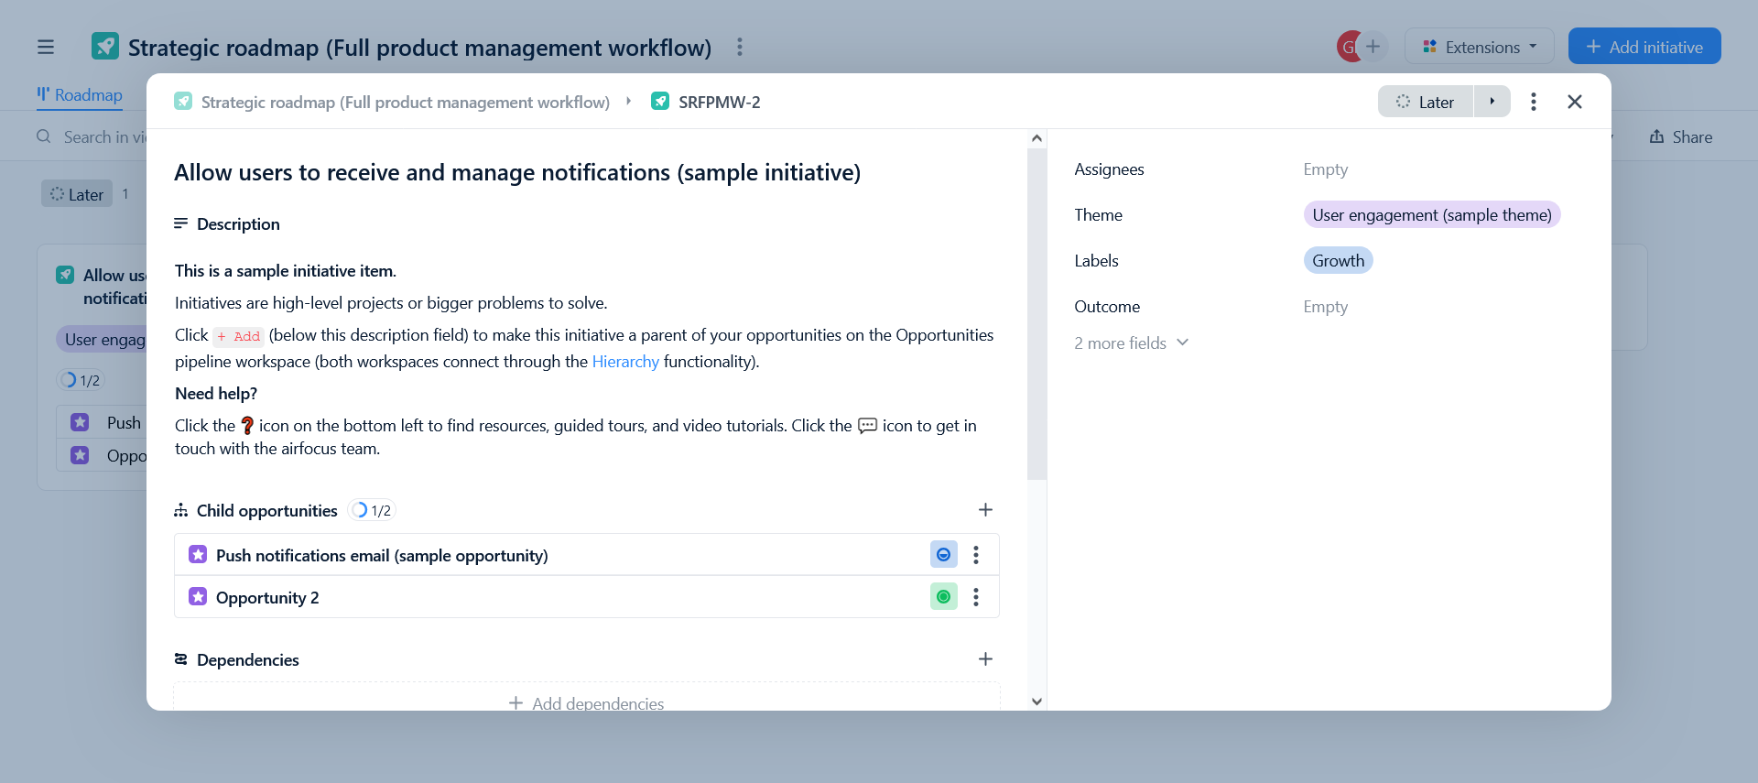

Slide 46
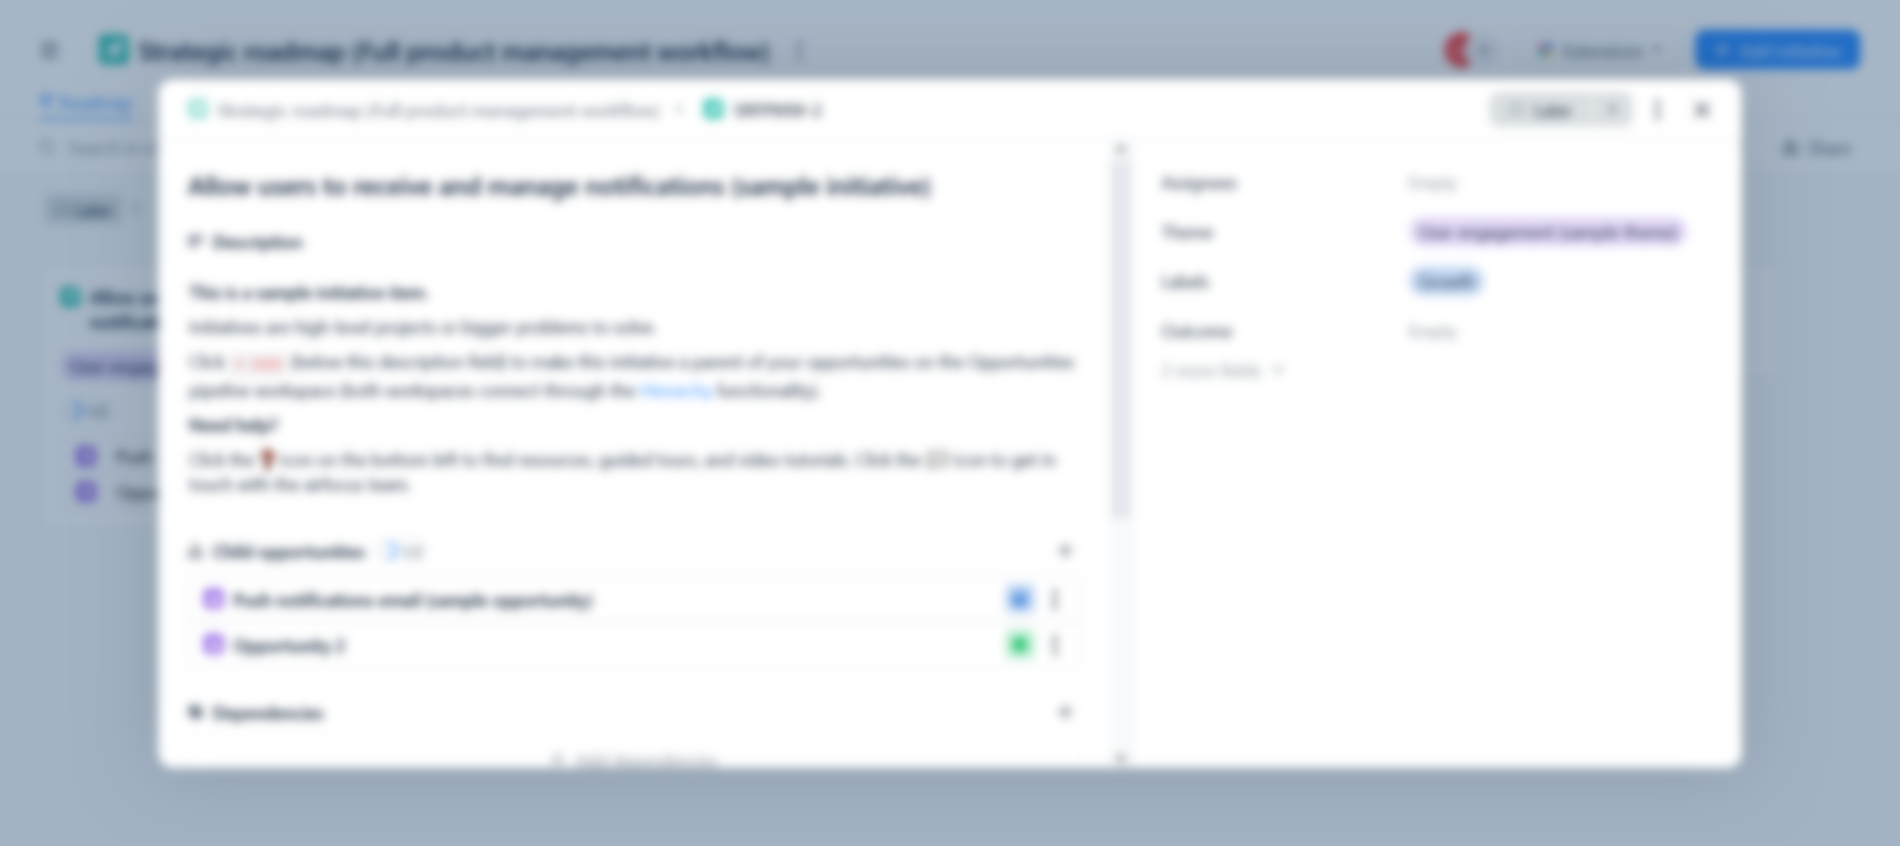

Slide 48
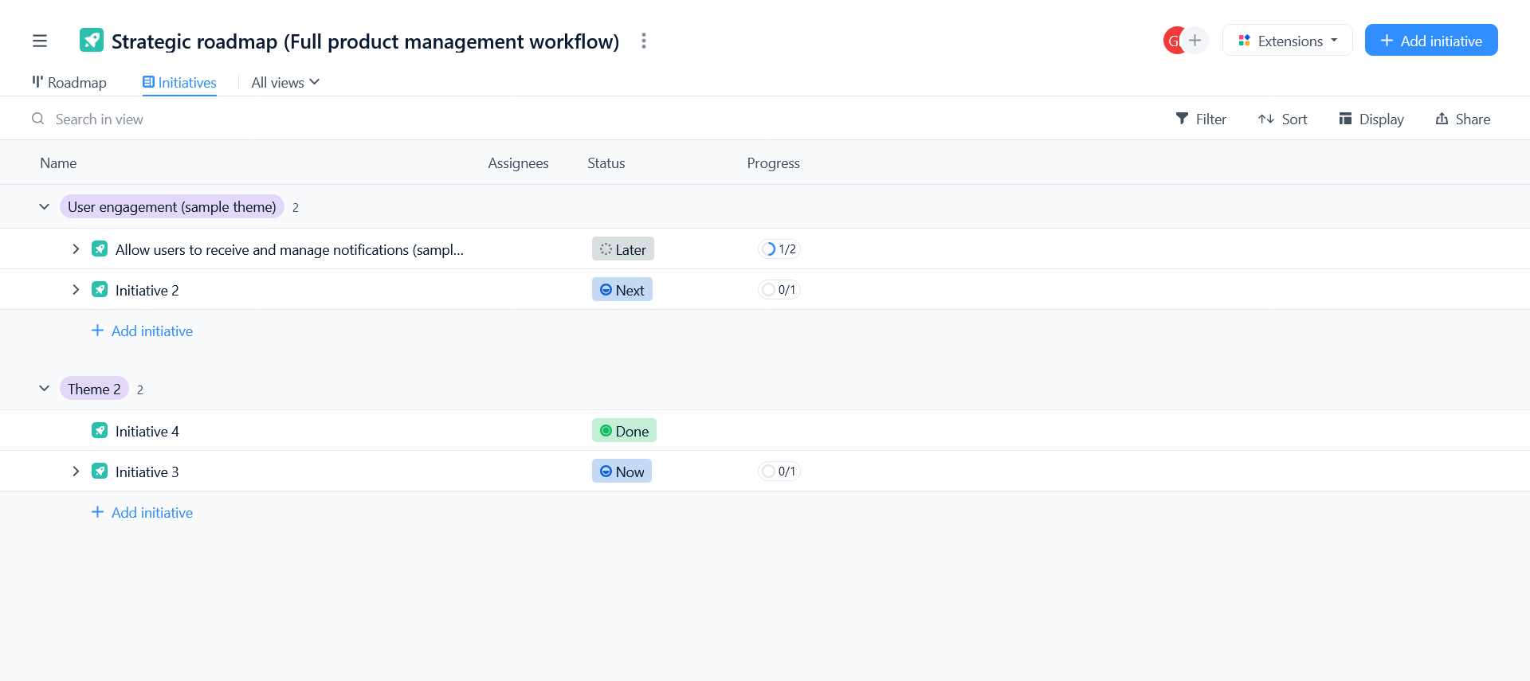

Opportunity pipeline

Slide 49
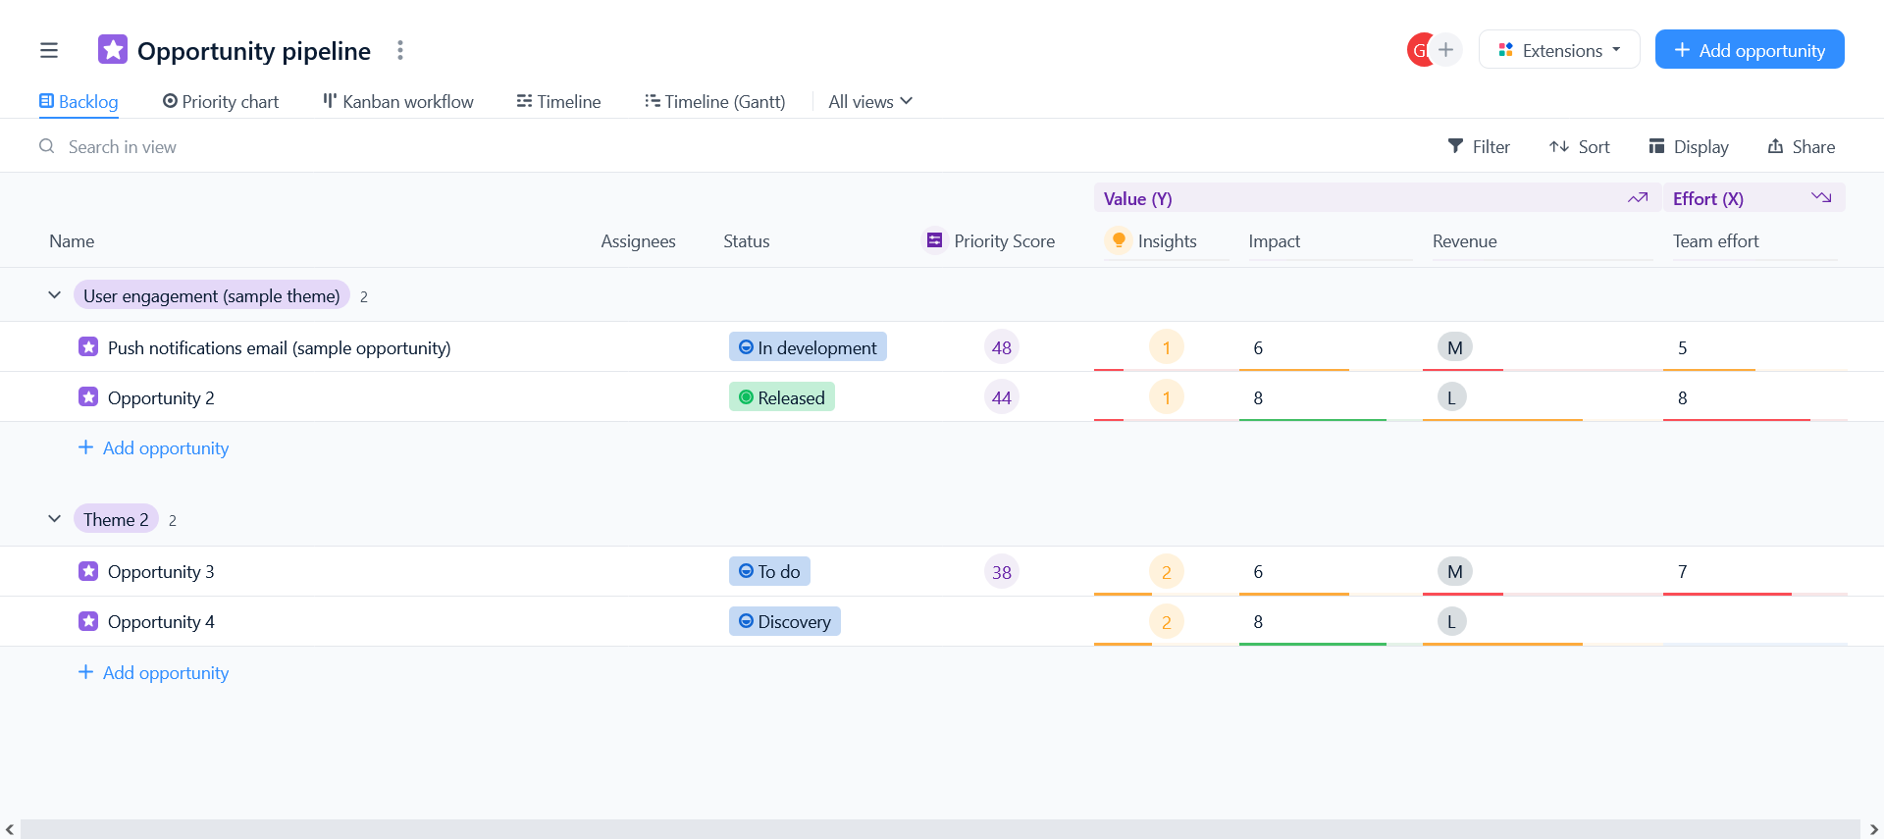

Opportunity pipeline

Slide 50
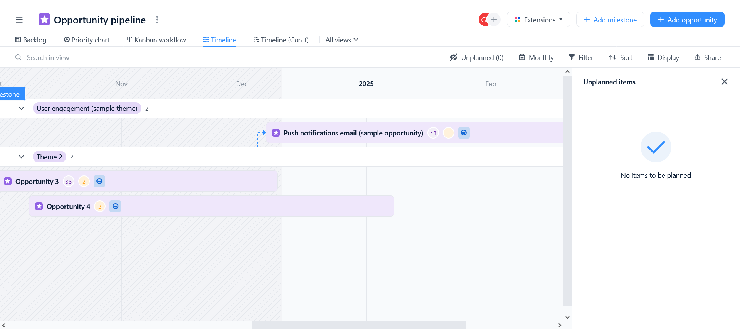

Opportunity pipeline

Slide 52
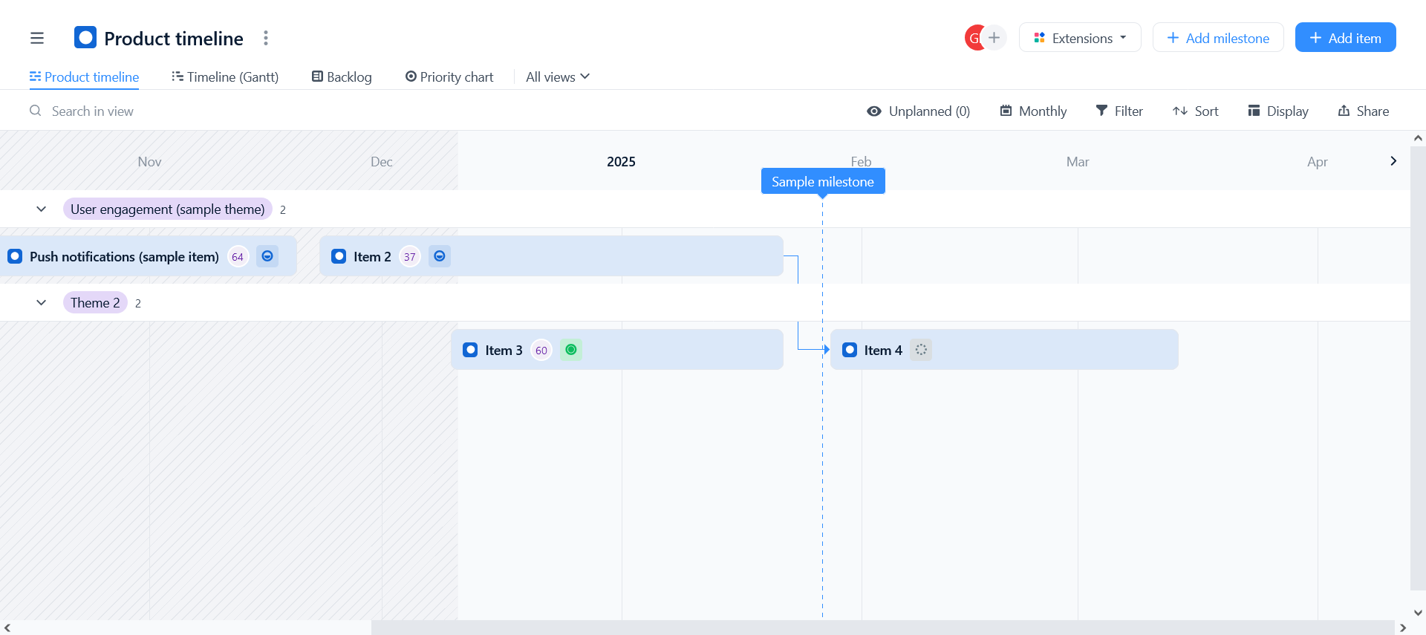

Product
Timeline

Slide 53
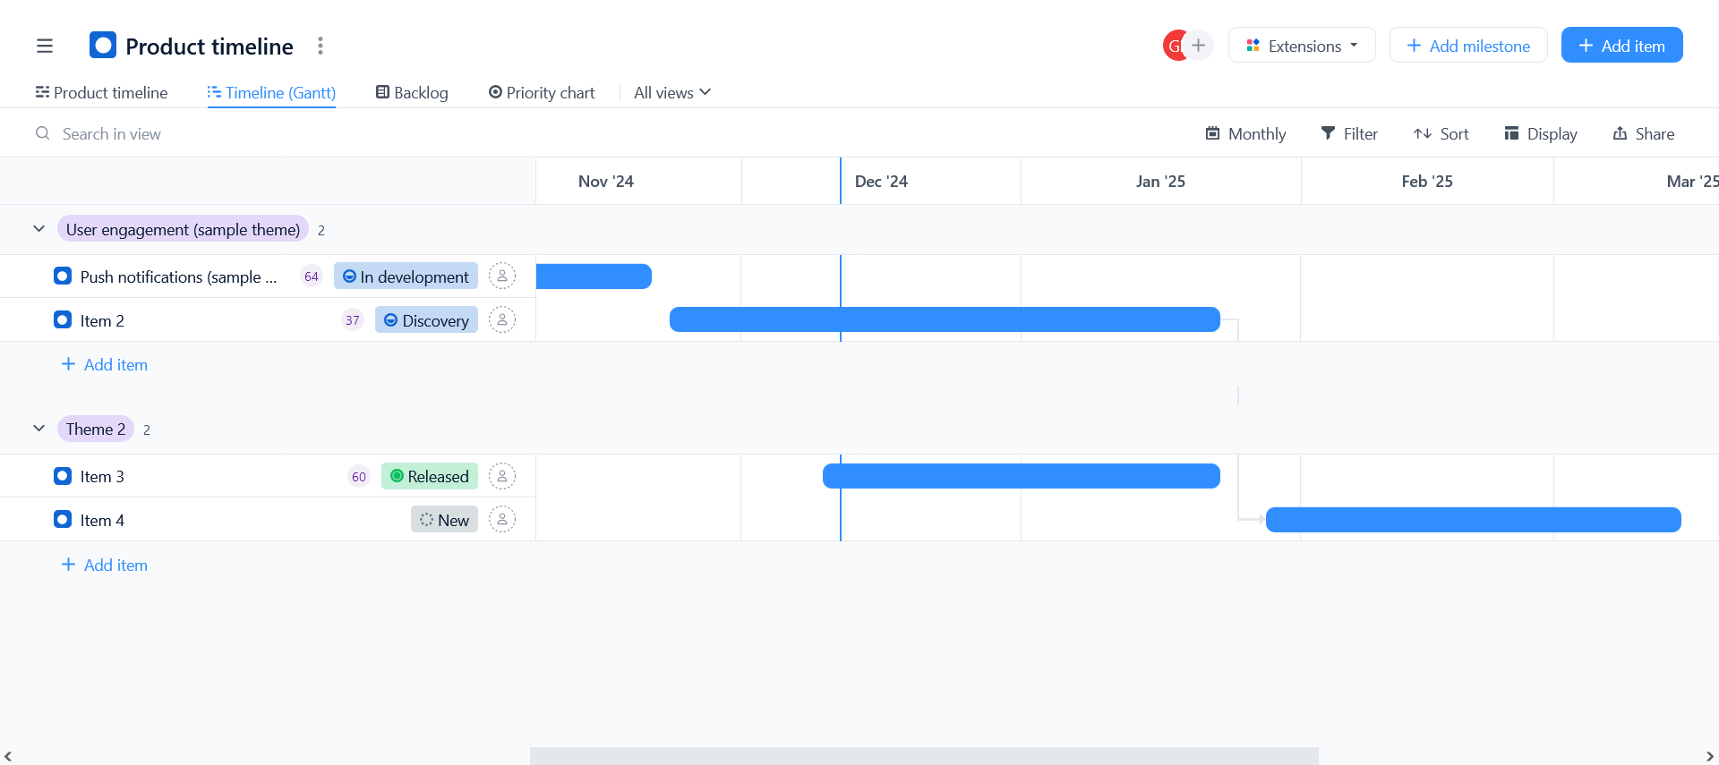
Product
Timeline

Slide 54
THANK
YOU

Slide 55
THANK
YOU

